Slide 1

SUMMER INTERNSHIP 2026
Camera-Based Robot Alignment
Using Artificial Intelligence
JAKA MINI 2 ROBOTIC ARM
Yosser Kallel AI & Data Science | TEK-UP Univeristy Supervisor: Mohamed Amine Mansour
ROBOT
COMPUTER VISION
AI

Slide 2
PROJECT CONTEXT
Overview
Objective
Camera
Develop a vision-based robotic system capable of:
↓
1
Detecting objects using AI
YOLO Detection
2
Extracting object position
↓
3
Sending information through ROS2
ROS2
4
Moving the robotic arm toward the detected object
↓
JAKA Robot
Main Concept
Camera → AI → Robot Motion
JAKA MINI 2 — CAMERA-BASED ROBOT ALIGNMENT
04

Slide 3
PLANNING
Initial Project Objectives
CORE OBJECTIVES
AI EXTENSIONS
●
Computer vision integration
♦
YOLO-based smart detection
◆
Object localization
▣
Performance monitoring and analysis
■
Robot movement control
Proposed as stretch goals to strengthen the vision pipeline beyond baseline detection and control.
▲
Visual alignment
JAKA MINI 2 — CAMERA-BASED ROBOT ALIGNMENT
05

Slide 4
PLANNING
Initial Roadmap — 4-Week Plan
⚙
◉
▲
✓
WEEK 1
WEEK 2
WEEK 3
WEEK 4
Setup
→
Vision
→
AI
→
Testing
Environment setup
ROS2 & simulation
Camera integration
Object detection
YOLO integration
ROS2 connection
Code was completed and fully functional in the simulator
Testing
Optimization
Documentation
The code was modified and configured to run on the real robot.
JAKA MINI 2 — CAMERA-BASED ROBOT ALIGNMENT
06

Slide 5
TOOLCHAIN
Technologies & Tools
DEVELOPMENT
AI & VISION
Python
Ubuntu
GitHub
Jira
OpenCV
YOLOv8
JAKA
ROBOT
PROJECT
ROBOTICS
ROS2 Humble • MoveIt2 • Gazebo Fortress • RViz2 • JAKA SDK
JAKA MINI 2 — CAMERA-BASED ROBOT ALIGNMENT
07

Slide 6
01
System Architecture & Execution
How the pipeline was designed, and what was built during the internship
JAKA MINI 2 — CAMERA-BASED ROBOT ALIGNMENT
08

Slide 7
SYSTEM ARCHITECTURE
Complete Workflow
Camera
HARDWARE
LEGEND
↓
Software
YOLO Object Detection
AI
Robot
↓
AI
Python Processing Node
SOFTWARE
↓
ROS2 Communication
SOFTWARE
PIPELINE SUMMARY
↓
Visual input is detected and localized by AI, converted into 2-D coordinates, and streamed over ROS2 to drive the JAKA arm inside the Gazebo simulation in real time.
Coordinate Processing
SOFTWARE
↓
Robot Control
ROBOT
↓
Gazebo Simulation
ROBOT
JAKA MINI 2 — CAMERA-BASED ROBOT ALIGNMENT
09

Slide 8
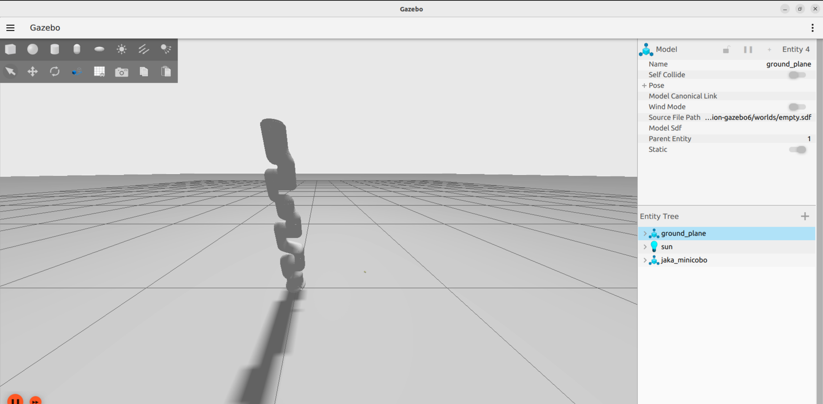
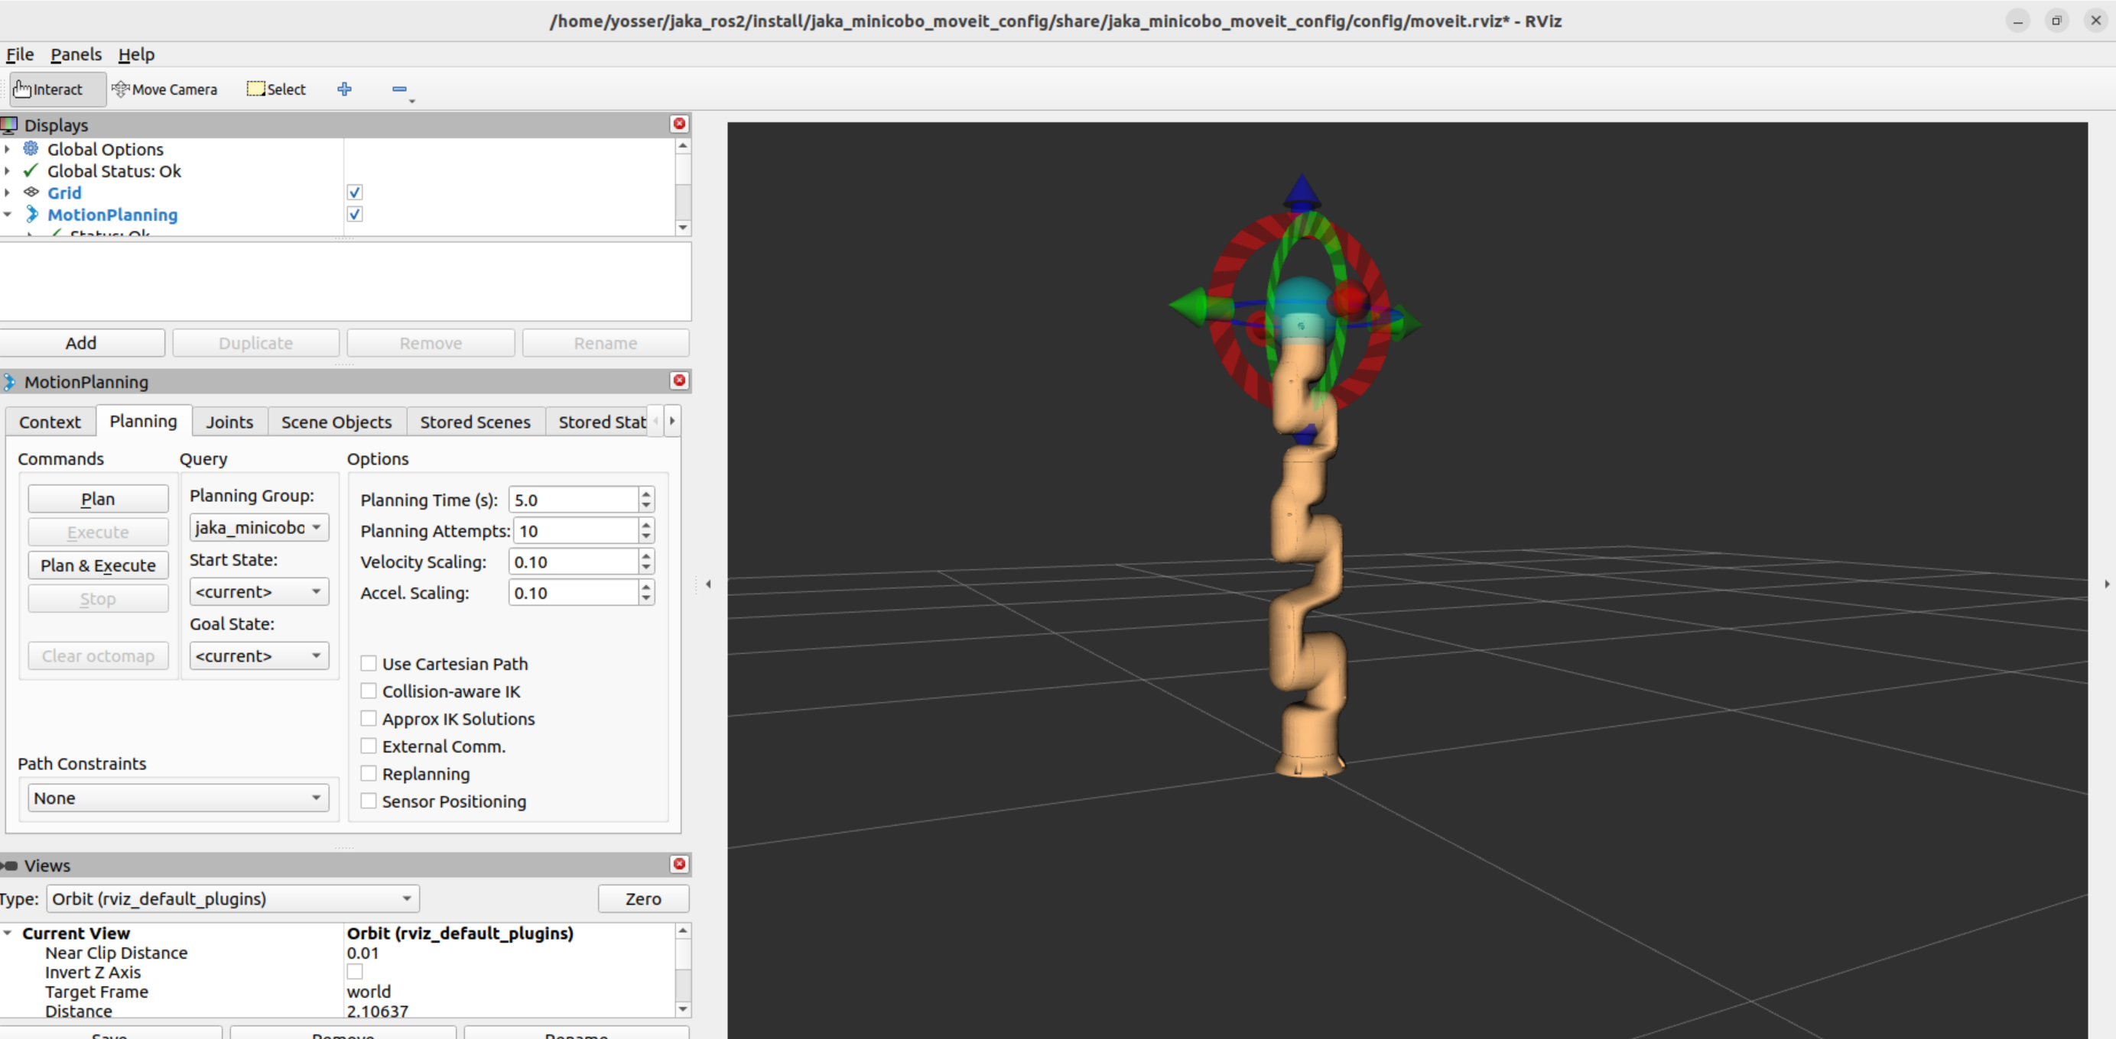
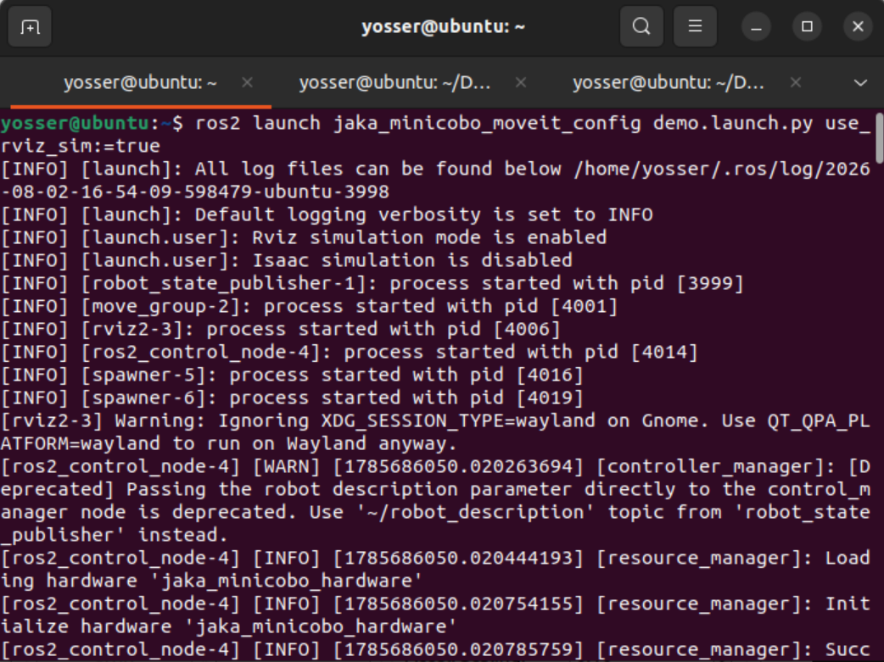
WORK COMPLETED
Environment & Simulation
Gazebo Robot View
✓
ROS2 Humble setup
✓
Gazebo simulation
✓
RViz visualization
✓
JAKA robot integration
✓
Motion testing
RViz Robot Model
Terminal — ROS2 Nodes
10

Slide 9
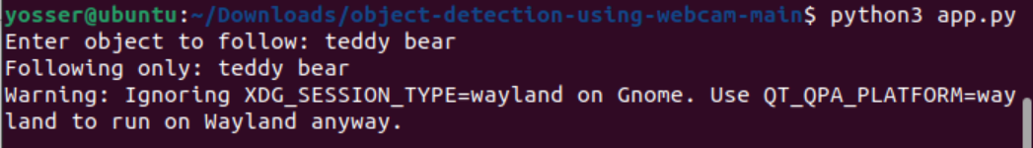
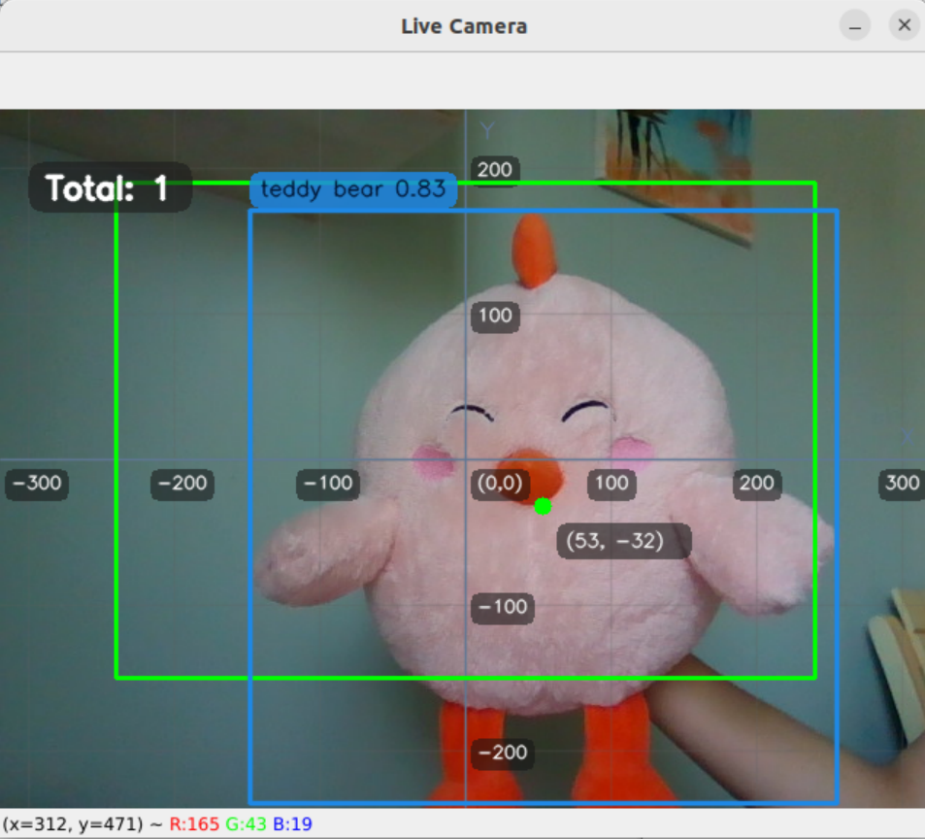
WORK COMPLETED
AI Object Detection
Computer Vision Pipeline
1
Camera acquisition
2
YOLOv8 detection
3
Object recognition
4
Position extraction
The system detects objects and provides their coordinates for robot control.
SAMPLE DETECTION RESULT
Teddy Bear • 83% confidence • (x, y) = (53, -32)
JAKA MINI 2 — CAMERA-BASED ROBOT ALIGNMENT
11

Slide 10
02
Results & Reflection
Challenges faced, outcomes achieved, and what was delivered
JAKA MINI 2 — CAMERA-BASED ROBOT ALIGNMENT
12

Slide 11
OBSTACLES
Challenges Encountered
ROS2 Environment
Gazebo Simulation
!
Complex installation and dependencies
!
Launch and package issues
✓
Configuration and troubleshooting
✓
Debugging launch files and configurations
AI Integration
Camera & Calibration
!
Library compatibility issues
!
Connecting vision information with robot coordinates
✓
Managing Python dependencies
✓
Testing and improving coordinate mapping
JAKA MINI 2 — CAMERA-BASED ROBOT ALIGNMENT
13

Slide 12
OUTCOMES
Results Achieved
✓
Complete robotic simulation environment
✓
AI-based object detection
✓
ROS2 communication pipeline
✓
Object coordinates transmission
✓
Robot movement toward detected objects
JAKA MINI 2 — CAMERA-BASED ROBOT ALIGNMENT
14

Slide 13
WRAP-UP
Deliverables
▣
⚙
≡
◈
Source Code
ROS2 Workspace
Documentation
GitHub Repository
◉
▶
▤
Simulation Demo
Internship Report
JAKA MINI 2 — CAMERA-BASED ROBOT ALIGNMENT
15

Slide 14
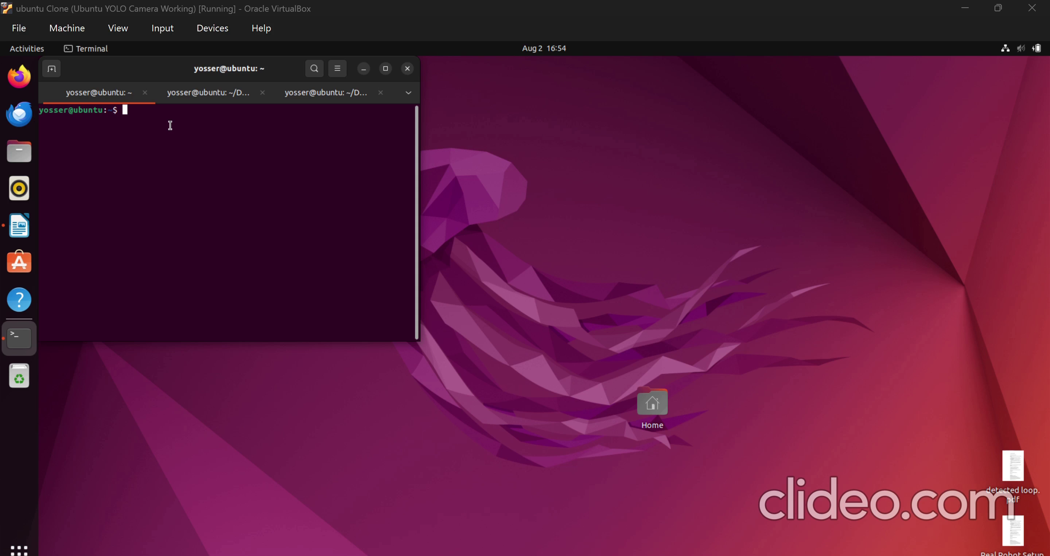
Simulation Demonstration
VALIDATION SESSION
TU
FUTURE REAL ROBOT DEMO
A physical JAKA Mini 2 demonstration will be recorded and uploaded to Google Drive after the lab session.
▶
The demo shows: object detection • coordinate extraction • ROS2 communication • robot movement
JAKA MINI 2 — CAMERA-BASED ROBOT ALIGNMENT
16
Notes:
For this validation session, I prepared a simulation demonstration showing the complete software pipeline. I could not record the physical robot demonstration last week because I was preparing for a university certification, which required additional time. I plan to perform the real robot demonstration in the laboratory next week and upload the recording to the shared drive.

Slide 15
WHAT'S NEXT
Future Improvements
Current System
→
Improvements
→
Full Autonomous Robot
Simulation-based detection
ROS2 pipeline validated
Real robot deployment
Camera calibration improvement
Better coordinate transformation
Complete visual servoing loop
Performance analysis
JAKA MINI 2 — CAMERA-BASED ROBOT ALIGNMENT
17

Slide 16
CONCLUSION
The project demonstrated the integration of:
Artificial Intelligence + Computer Vision + Robotics
✓
A working blueprint for vision-guided automation
✓
Directly transferable to real industrial cobots like JAKA
■
✓
Hands-on experience across AI, robotics & systems integration
✓
A strong stepping stone toward a robotics/AI career
JAKA MINI 2 — CAMERA-BASED ROBOT ALIGNMENT
20

Slide 17
Thank You
Questions & Discussion
JAKA MINI 2 — CAMERA-BASED ROBOT ALIGNMENT
21

